Slide 1



Chapter 5
Science & Technology

Slide 2

学习目标
了解中国古代科技成果；
了解中国现代科技成果；
能够用英语介绍中国科技成果。

Slide 3
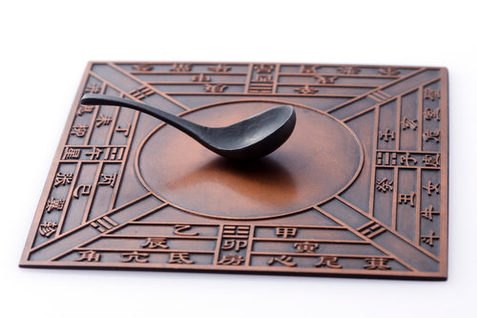
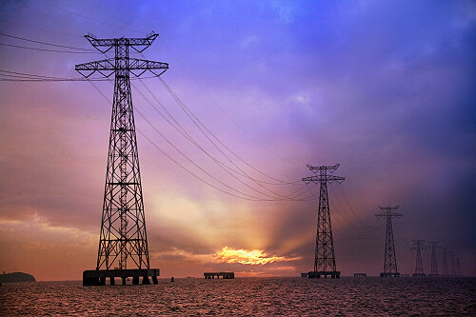
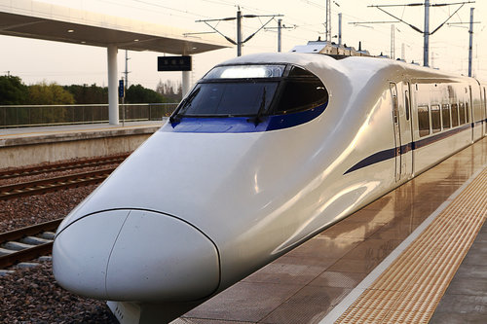
1
2
Overview
3
Lead-in Activity
Chinese Science and
Technology
Discussion &
Presentation

Slide 4
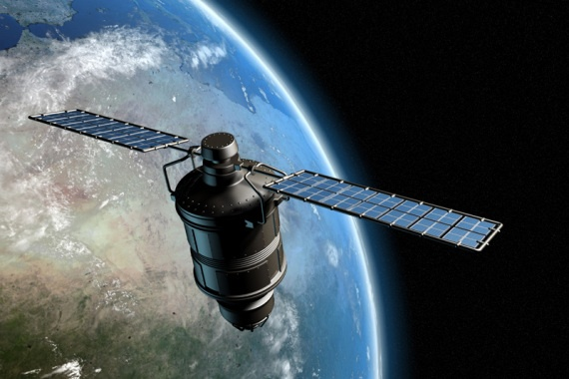
Lead-in Activity
Discuss
Among all the scientific and technological achievements, what do you think is the most essential for you and why?
Do you think that modern technology is a double-edged sword, benefiting and damaging our lives at the same time?

Slide 5
1
2
Overview
3
Lead-in Activity
Chinese Science and
Technology
Discussion &
Presentation

Slide 6
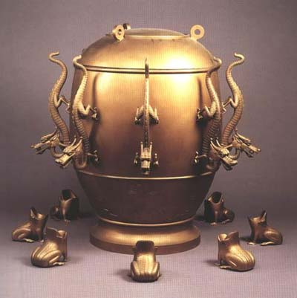
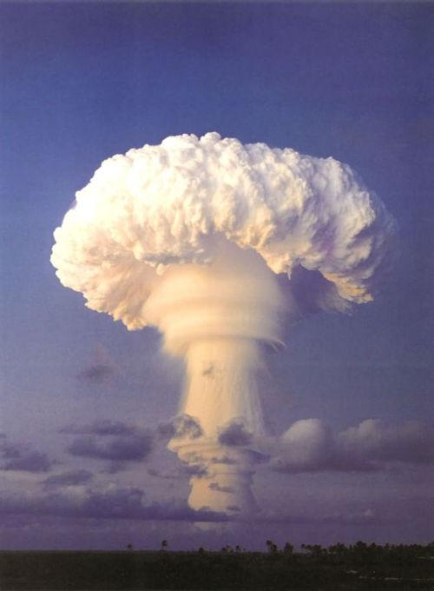
Chinese Science and Technology
1
2
Ancient Science and Technology
Modern Scientific and Technological Achievements

Slide 7
Ancient Science and Technology
Four Great Inventions
Traditional Chinese Medicine
Other Impressive Ancient Inventions

Slide 8
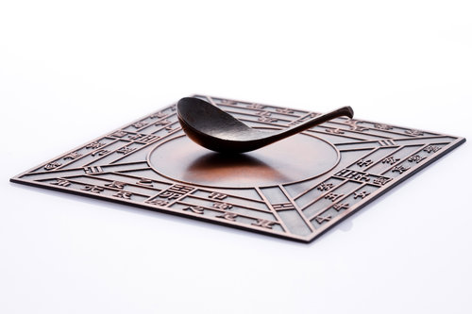
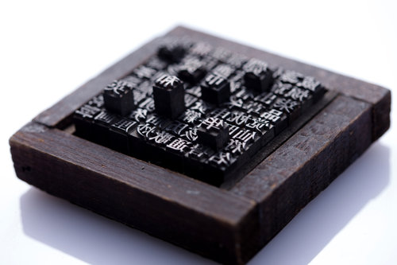
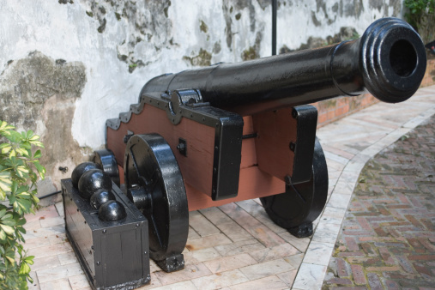
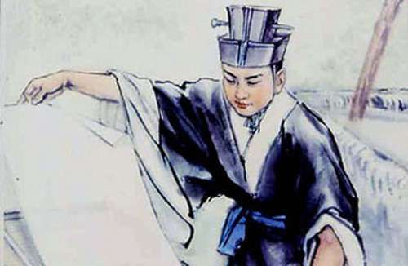
Four Great Inventions
Do you know what are the four great inventions of China ?
compass
printing
gunpowder
paper-making

Slide 9
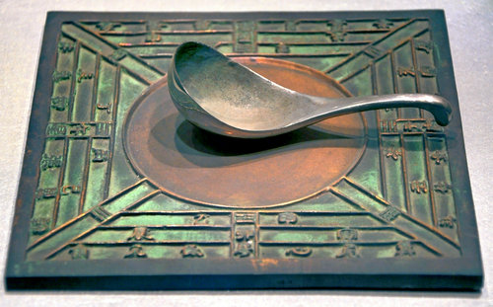
Four Great Inventions
Compass
shows geographic directions
use the earth’s magnetic field
enables international trade and
exploration
denotes eight main directions
helpful for the explorations of Zheng
He, Christopher Columbus, etc.

Slide 10
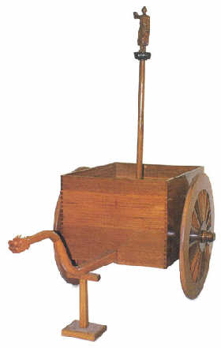
Four Great Inventions
Compass Vehicle
equipped with gear wheels and a
wooden figure
always points south
an earlier and more primitive form of
compass

Slide 11

Four Great Inventions
Gunpowder
invented by alchemists seeking the
elixir of immortality
military applications began in the Tang
dynasty
introduced to the Arab world and
Europe in the Yuan dynasty
brought a series of revolutions to
weapon manufacturing

Slide 12
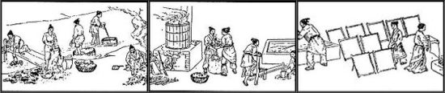
Four Great Inventions
Paper-making
invented by Cai Lun using cheap materials such as bark,
hemp, rags, and other materials
introduced to the world, contributing the dissemination of
knowledge

Slide 13
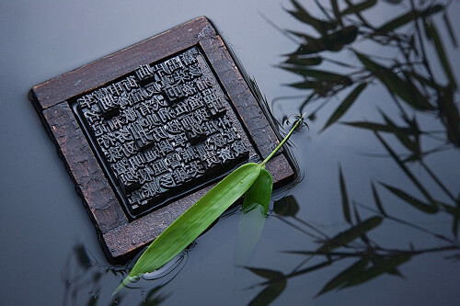
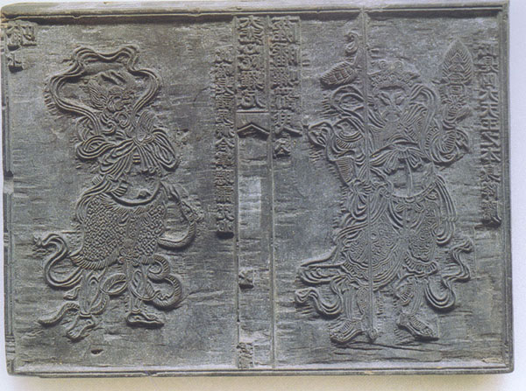
Four Great Inventions
Printing
known as “mother of civilization”
includes block printing and movable
type printing
block printing is time-consuming and
the blocks become useless after the
printing
movable type printing is more
convenient with the pieces being
durable and reusable

Slide 14
Ancient Science and Technology
Four Great Inventions
Traditional Chinese Medicine
Other Impressive Ancient Inventions

Slide 15
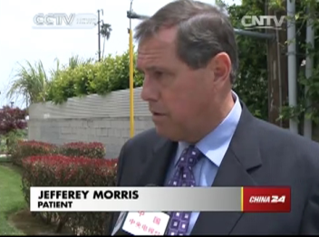

Traditional Chinese Medicine
Watch the & Discuss
Is traditional Chinese medicine (TCM) welcomed in the US and why?

Slide 16
Traditional Chinese Medicine
Outline
has a long history and still popular today
different from Western medicine in its means of diagnosis and
treatment, and its composition of drugs and prescriptions
a holistic approach is taken for diagnosis, diet, age, habits, emotions,
lifestyle and living environments are all taken into consideration
based on the idea that the cause of sickness is an imbalance and
blockage of the flow of qi
emphasizes on preventing illness
the four methods of diagnosis include observation, auscultation and
olfaction, interrogation, and palpation

Slide 17
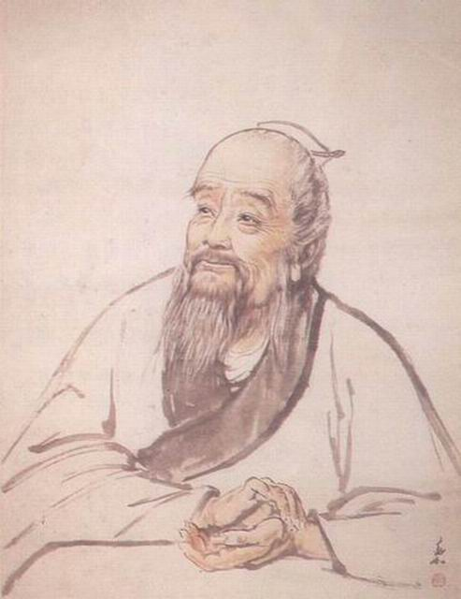
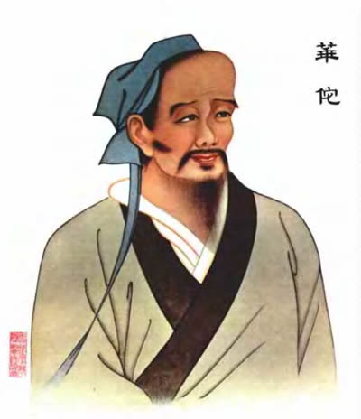
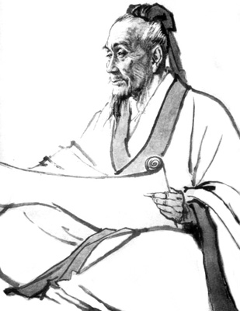
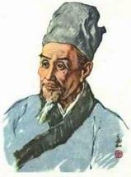
Traditional Chinese Medicine
Can you match the medical experts with the right descriptions?
Bian Que
Hua Tuo
Li Shizhen
Zhang Zhongjing
the author of On Diseases (《伤寒杂病论》) ______________
the author of Compendium of Meteria Medica (《本草纲目》) _________
the inventor of the four methods of diagnosis: observation, auscultation and olfaction, interrogation, and palpation / the earliest known Chinese physician _________
the inventor of the “Five-Animal Exercises (五禽戏)” ________
Zhang Zhongjing
Li Shizhen
Bian Que
Hua Tuo

Slide 18
Ancient Science and Technology
Four Great Inventions
Traditional Chinese Medicine
Other Impressive Ancient Inventions

Slide 19

Other Impressive Ancient Inventions
Fireworks
probably first made by stuffing
gunpowder into bamboo sticks
the explosions can scare off evil spirits
and ghosts
setting off fireworks on holidays is still
popular

Slide 20

Other Impressive Ancient Inventions
Silk
first developed in ancient China
first found as early as 3,500 BC
originally reserved for the emperors
and nobles
later spread to other parts of the
world

Slide 21
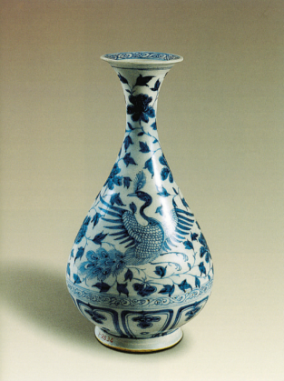
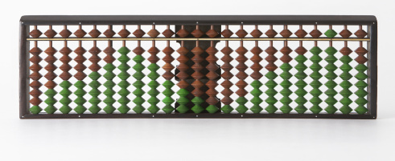
Other Impressive Ancient Inventions
Porcelain
made generally from clay
heated at a high degree
the first glazing color is blue
Abacus
an early form of calculator
a frame with rows of beads around
the rods
used for four fundamental operations
of arithmetic

Slide 22
Other Impressive Ancient Inventions
Seismograph
invented by Zhang Heng
used to indicate the direction of a
distant earthquake
a similar instrument invented in
Europe over 1,700 years later

Slide 23
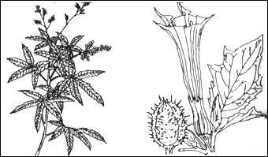
Other Impressive Ancient Inventions
Anaethetic
used for surgical operations
exampled by “toxic wine” invented by Bian Que and
mafeisan invented by Hua Tuo

Slide 24
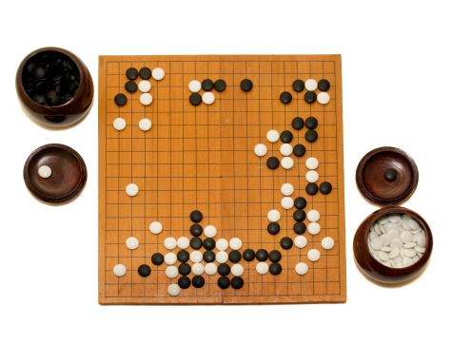
Other Impressive Ancient Inventions
Weiqi
a popular board game originates in China
played on a square wooden board of 361 intersections
the person who has the most pieces walled in will be
declared as the winner

Slide 25
Chinese Science and Technology
1
2
Ancient Science and Technology
Modern Scientific and Technological Achievements

Slide 26
Modern Scientific and Technological Achievements
Atomic Energy
1958 heralds China’s entry into the atomic age
China being one of the few countries in the world that have
the technology of exploring atomic energy

Slide 27
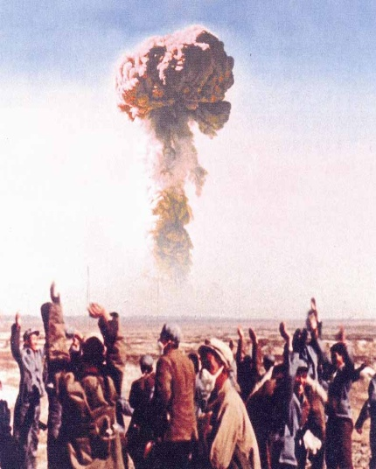
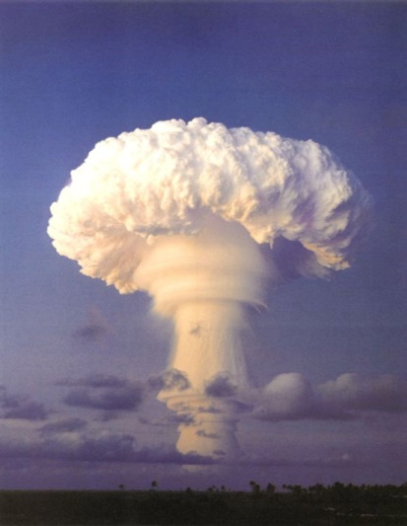
Modern Scientific and Technological Achievements
Nuclear and Hydrogen Bombs
1964, China’s first nuclear bomb was exploded
China being the 5th country with atomic weapon after the US,
the former Soviet Union, Britain, and France
China’s first hydrogen bomb was exploded in 1967

Slide 28
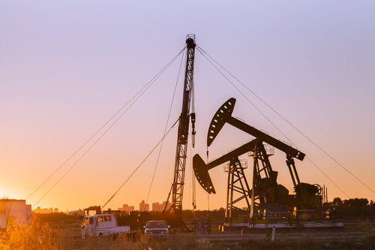
Modern Scientific and Technological Achievements
Oil Production
Daqing Oil Field, which was discovered in 1959, enabled
China to be one of the major oil-producing countries

Slide 29
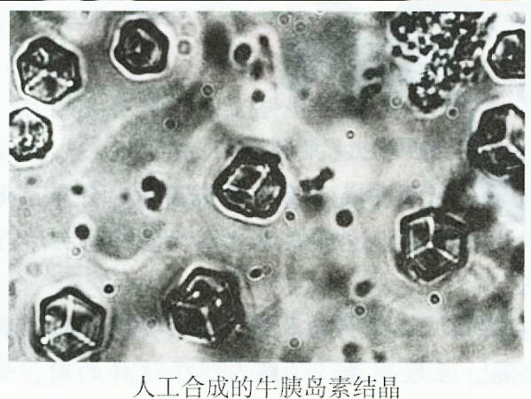
Modern Scientific and Technological Achievements
Synthesised Crrystalline Bovine Insulin
crystalline bovine insulin was synthesised in 1965
enables China to be the world leader in the research field

Slide 30
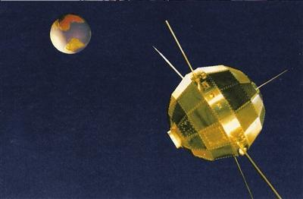
Modern Scientific and Technological Achievements
First Man-made Satellite
China’s space research started in the mid-1950s
China’s first man-made satellite Dongfanghong-1 launched in
1970

Slide 31
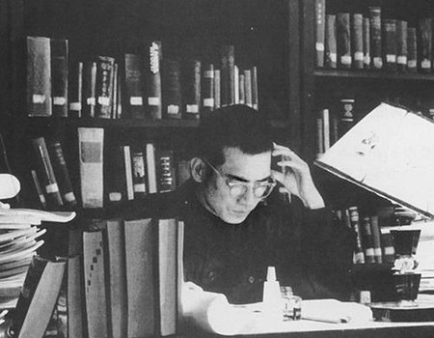
Modern Scientific and Technological Achievements
Breakthrough in Goldbach’s Conjecture
Chen Jingrun solved the conjecture in 1978
the theory had remained unsolved for over 200 years
also referred to as Chen’s Theorem

Slide 32
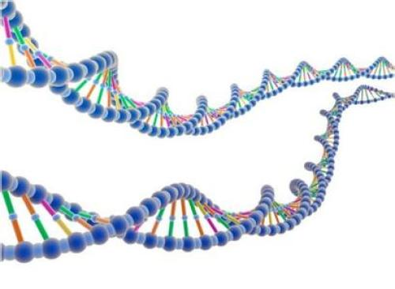
Modern Scientific and Technological Achievements
Research on RNA Semi-Molecule(核糖核酸半分子)
an RNA semi-molecule composed of 41 nucleotides
synthesised in 1979
of great significance in research into genetic engineering,
viruses and tumours

Slide 33

Modern Scientific and Technological Achievements
Five-Stoke Code Computer Input Method(五笔字型汉字输入)
with the method, Chinese characters could be input at the
speed of 100 characters per second
marked Chinese characters entering the information age

Slide 34
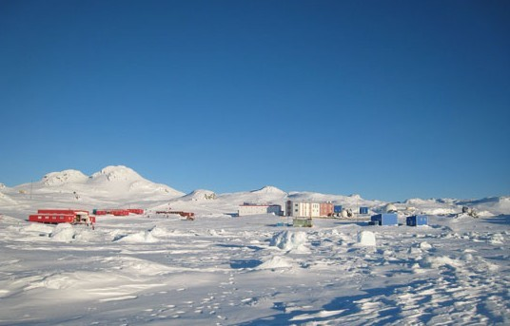
Modern Scientific and Technological Achievements
Great Wall Scientific Inspection Station at the South Pole
the research in South Pole was started in 1984 with the
sailing of Xiangyanghong-10
China South Pole Great Wall Station, Chinese’s first scientific
survey station, was built in 1985

Slide 35
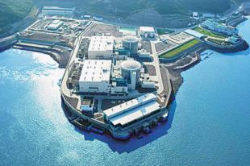
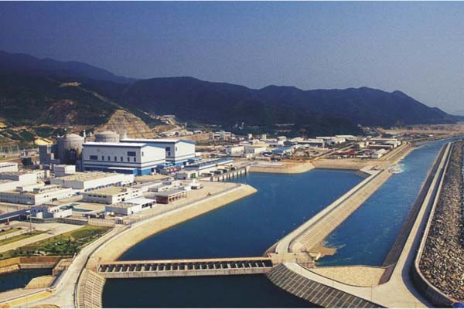
Modern Scientific and Technological Achievements
Nuclear Power Stations in China
exampled by Qinshan Nuclear Station and Dayawan Nuclear
Station
these two are pressurised water reactors

Slide 36
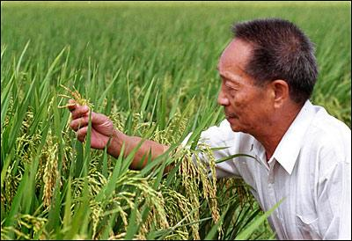
Modern Scientific and Technological Achievements
Yuan Longping and Hybrid Rice
revolutionized rice cultivation in China
established China’s world leading position in hybrid rice
research

Slide 37
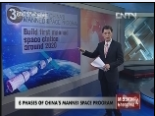
Modern Scientific and Technological Achievements
China’s Manned Space Program
Watch the video and answer the question: what are the three phases of China’s manned space program?

Slide 38
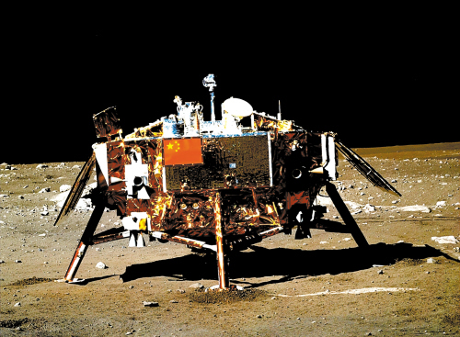
Modern Scientific and Technological Achievements
Chang’e-3 Lunar Lander and Its Yutu Lunar Rover
Chang’e-3 lunar lander landed on the moon in 2013
hailed as a milestone in the development of China’s space
programmes

Slide 39
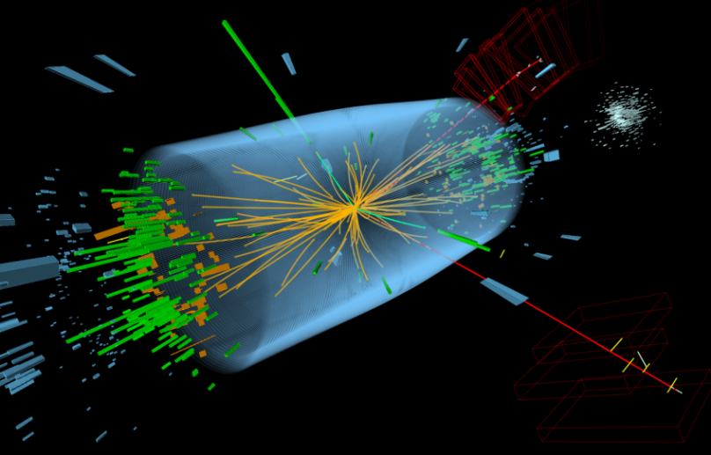
Modern Scientific and Technological Achievements
Some other Major Achievements
Research, development and application of super-conductivity
Positive and negative electron collider (正负电子对撞机)
2.16-meter optical celestial telescope
Tianhe-2 Supercomputer

Slide 40
1
2
Overview
3
Lead-in Activity
Chinese Science and
Technology
Discussion &
Presentation

Slide 41
Discussion
Differences between Traditional Chinese Medicine and Western Medicine
 | Traditional Chinese Medicine | Western Medicine
approach | inductive and synthetic | reductive and analytical
treatment | herbs | chemical drugs
foundation | experience | standards and evidence
starting point | treat the whole body | treat a particular part

Slide 42

Discussion
Catching a cold is terrible, but since there are so many kinds of medicine on the market, you may feel confusing what to choose. Please discuss with your partner about your preference between traditional Chinese medicine and Western medicine and explain your reasons. Then share your ideas with the class.

Slide 43

Students’ Presentation
You are a university student applying for volunteering in China Science and Technology Museum. To qualify for the job, you have to prepare a two-minute presentation on China’s recent technological achievements in exploration of outer space. You can turn to the Internet to collect some information for your presentation.

Slide 44

The End

